Slide 1
Pyramid Mixer: Multi-dimensional Multi-period Interest Modeling for Sequential Recommendation
Zhen Gong, Faisal Shehzad (Proxy presenter)
Emails: Gongzhen.666@bytedance.com

Slide 2

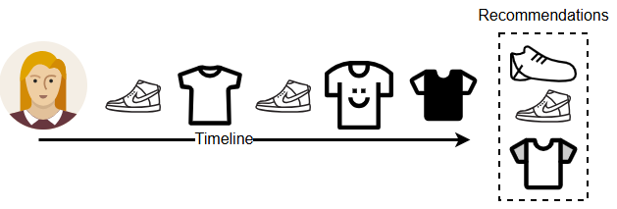
Introduction
Recommender system
A recommender system is software that suggests items (such as videos, songs, or other content) to users based on their preferences
Sequential Recommender system
Makes suggestions by analyzing the order in which a user interacts with items over time
1

Slide 3
Motivation and problem statement
Existing studies use attention mechanisms to capture hidden patterns in a user behavior [1, 2, 3], but neglect relationship among and within:
Behaviors
Features
Short and long interests
Secondly, the computational complexity of the self-attention mechanism makes difficult to apply them in large-scale industrial applications
However, MLP architectures could be a potential solution for this problem
MLP architectures demonstrate competitive performance in both academia and industry due to their efficiency and simplicity
2

Slide 4
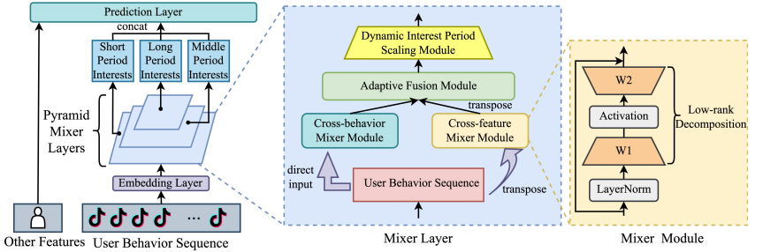
Proposed model (1 / 2)
In this study, we propose a Pyramid Mixer model
Contains mixer layers, which process user-embedding sequence at multiple scales
Within each mixer layer, cross-behavior and cross feature mixer modules are employed
Both cross-behavior and cross feature modules integrate user behaviors and item features, respectively
3
Notes:
Other features:
Authors id, category, Playtime, Like count, User Action type, timestamp info, play time

Slide 5
Proposed model (2 / 2)
Adaptive Fusion module: used to combine output of both modules
Pyramid network helps to retrieve short, middle and long period interest of a user
Low rank decomposition used to overcome over-parameterization problem
Multi-scale cross period module used to learn temporal patterns within and among different time periods
4
Notes:
Other features:
Authors id, category, Playtime, Like count, User Action type, timestamp info, play time

Slide 6
Experiment settings
Datasets
MovieLens-100k
MovieLens-1M
Beauty dataset from Amazon
One private dataset from Douyin app
Metrics
HR@10
MRR@20
NDCG@10
AUC and UAUC
Baselines
Pop, BPR [4], FPMC [5], GRU4Rec [6], SeSRec [7], BERT4Rec [8], FMLP [9], MLP-Mixer [10] and MLP4Rec [11]
5
Notes:
Other features:
Authors id, category, Playtime, Like count, User Action type, timestamp info, play time

Slide 7
Results (1/3)
RQ1: Can our proposed model outperform the state-of-the-art baselines in sequential recommendation tasks?
Datasets / Metrics | HR@10 | NDCG@10 | MRR@20
MovieLens-100k | Pyramid Mixer | Pyramid Mixer | Pyramid Mixer
MovieLens-1M | Pyramid Mixer | Pyramid Mixer | Pyramid Mixer
Beauty | Pyramid Mixer | Pyramid Mixer | Pyramid Mixer
Findings
Pyramid Mixer outperforms all baseline models on accuracy measures for all three datasets
On larger dataset, such as Beauty, the model performs even better that demonstrates its scalability
6

Slide 8
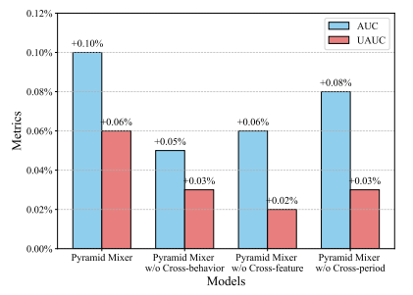
Results (2/3)
RQ2: What are the effects of key components of Pyramid Mixer?
Findings
Measure the performance of Pyramid Mixer on a industrial dataset using AUC and UAUC measures
Complete Pyramid mixer shows competitive, which demonstrates the effectiveness of each module/component
7

Slide 9
Results (3/3)
RQ3: How does the Pyramid Mixer perform in the online settings?
Online experiment core metric results
Metric | Active days | Active hours | Stay duration | Playtime
A/B result | +0.0403% | +0.0476% | +0.0853% | +0.1106%
Online experiments interactions results
Metric | Publish | Play | Finish | Like
A/B result | +0.093% | 0.0538% | +0.1801% | +0.1761%
Metric | Dislike | Comment | Share | Follow
A/B result | -0.0145% | +0.2074% | +0.2284% | +0.4876%
8

Slide 10
Conclusions / Future work
In this study, we introduce the Pyramid Mixer model for sequential recommendation
In the future, we will test its performance in top-n collaborative filtering and session-based recommendation
We plan to conduct further experiments using additional side information such as location and other contextual features
Combine the MLP mixer with an attention mechanism
Evaluate the performance of the MLP-mixer using embeddings from LLMs models
9

Slide 11
References
Fan, Xinyan, et al. "Lighter and Better: Low-rank Decomposed Self-attention Networks for Next-item Recommendation." Proceedings of the 44th International ACM SIGIR Conference on Research and Development in Information Retrieval. 2021.
Kang, Wang-Cheng, and Julian McAuley. "Self-attentive Sequential Recommendation." 2018 IEEE International Conference on Data Mining (ICDM). IEEE, 2018.
Wu, Chuhan, et al. "Neural News Recommendation with Multi-head Self-attention." Proceedings of the 2019 Conference on Empirical Methods in Natural Language Processing and the 9th International Joint Conference on Natural Language Processing (EMNLP-IJCNLP). 2019.
Rendle, Steffen, et al. "BPR: Bayesian Personalized Ranking from Implicit Feedback." arXiv preprint arXiv:1205.2618 (2012).
Rendle, Steffen, Christoph Freudenthaler, and Lars Schmidt-Thieme. "Factorizing Personalized Markov Chains for Next-basket Recommendation." Proceedings of the 19th International Conference on World Wide Web. 2010.
Hidasi, Balázs, et al. "Session-based Recommendations with Recurrent Neural Networks." arXiv preprint arXiv:1511.06939 (2015).
Kang, Wang-Cheng, and Julian McAuley. "Self-attentive Sequential Recommendation." 2018 IEEE International Conference on Data Mining (ICDM). IEEE, 2018.
Sun, Fei, et al. "BERT4Rec: Sequential Recommendation with Bidirectional Encoder Representations From Transformer." Proceedings of the 28th ACM International Conference on Information and Knowledge Management. 2019.
Tolstikhin, Ilya O., et al. "Mlp-mixer: An all-mlp Architecture for Vision." Advances in Neural Information Processing Systems 34 (2021): 24261-24272.
Li, Muyang, et al. "MLP4Rec: A Pure MLP Architecture for Sequential Recommendations." arXiv preprint arXiv:2204.11510 (2022).
10

